Slide 1


FULL STACK WEB DEVELOPMENT WITH DJANGO
Lecture 12

Slide 2

Today’s Agenda
Developing Our Django App
Template Inheritance
Example

Slide 3
Template Inheritance
So far we have been creating very simple templates but in the real world, this is rarely the case.
To give a common look and feel across all the pages of a website some HTML code is repeated.
Typically header, navigation, footer, and sidebar remains the same throughout the site.
The problem arises when we want to modify some part of the page.
To better understand the issue, let’s take an example.

Slide 4
Template Inheritance
Suppose we have three pages namely home.html , showdatetime.html and contact.html.
HTML code for each of these pages is shown in the next slides

Slide 5
Template Inheritance
home.html
<!DOCTYPE html>
<html lang="en">
<head>
<meta charset="UTF-8">
<title>Home</title>
</head>
<body>
<nav>
<a href="#">Home</a>
<a href="#">Courses</a>
<a href="#">Contact</a>
<a href="#">Career</a>
</nav>

Slide 6
Template Inheritance
<h3>Sharma Computer Academy</h3>
<p>
We at SCA are a group of highly skilled and qualified software professionals,<br>
who are working towards to attain mutual goal,<br>
the goal of "Moulding The Talented into Most Demanded".<br>
SCA is a premier organization founded in 1998,<br>
growing as an IT Training/service providers<br>
and determined to set high standards in IT industry.
</p>
<p>
We are offering courses in latest technologies of IT<br>
like Python, Django, JSE, JEE,C#(sharp), Asp.Net,PHP, Android,Networking and IPv6 Area (CCNA, CNE6 – Level 1 (Silver) and CNE6 – Level 2 (Gold)).<br>
SCA PIP (“Project Implementation Program”) will help students<br>
acquire specialized skills for project development.
</p>
&copy; 2019. All rights reserved
</body>
</html>

Slide 7
Template Inheritance
showdatetime.html
<!DOCTYPE html>
<html lang="en">
<head>
<meta charset="UTF-8">
<title>Date and Time/title>
</head>
<body>
<nav>
<a href="#">Home</a>
<a href="#">Courses</a>
<a href="#">Contact</a>
<a href="#">Career</a>
</nav>
{% if now %}
<h2>Current date and time is {{ now }}</h2>
{% else %}
<h2>Date And Time Not Foumd!!</h2>
{% endif %}
&copy; 2019. All rights reserved
</body>
</html>

Slide 8
Template Inheritance
contact.html
<!DOCTYPE html>
<html lang="en">
<head>
<meta charset="UTF-8">
<title>Contact</title>
</head>
<body>
<nav>
<a href="#">Home</a>
<a href="#">Courses</a>
<a href="#">Contact</a>
<a href="#">Career</a>
</nav>

Slide 9
Template Inheritance
<h3>How To Reach Us?</h3>
<p>
In case of any queries , feel free to fill the form<br>
given below and our <b></b>Customer Support Team</b> will
contact you within 24 hours.
</p>
<p>
<form>
Name: <input type="text" name="name" required> <br>
Email: <input type="email" name="email" required> <br>
Query: <textarea required></textarea> <br>
<input type="submit" name="submit" value="Send">
</form>
</p>
&copy; 2017. All rights reserved
</body>
</html>

Slide 10
Template Inheritance
Now suppose at the time of making the site live the company decided to change the anchor text of a link in the navigation from Career to Jobs.
To make this change we have to manually visit each and every page.
What if we had 50 or 100 pages? These days it is very common for sites to have hundreds or even thousands of pages.

Slide 11
Template Inheritance
As we can see this method doesn’t scale very well.
So an optimized solution to this problem is Template Inheritance.

Slide 12
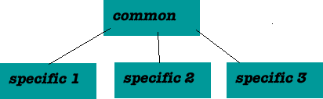
Template Inheritance
Template engines provide code reuse through inheritance, which is a concept also key to object-oriented programming.
With web page inheritance, we abstract the parts common to all web pages in one place, and let each specific page refer to these common parts.

Slide 13
Template Inheritance
If you are reading all these slides carefully, you might say “Why don’t we use include tag ?”.
Yes, sure we can use include tag to solve this particular problem very easily but as we will see Template Inheritance provides a much more powerful and elegant method to tackle issues like this.

Slide 14
Template Inheritance
To use Template Inheritance we must first create a base template.
A base template is just a simple skeleton that we will used as a base for all other pages on our site.
A base template defines areas where content can be inserted into.
In Django, we define this area using the block tag.

Slide 15
Template Inheritance
Create a new file named base.html inside the sitewide templates directory.
Now add the code shown in next slide into it

Slide 16
Template Inheritance
<!DOCTYPE html>
<html>
<head>
<title>{% block title %}Home{% endblock %}</title>
</head>
<body>
<nav>
<a href="#">Home</a>
<a href="#">Courses</a>
<a href="#">Contact</a>
<a href="#">Career</a>
</nav>
{% block content %}
{% endblock %}
<hr>
{% block footer %}
&copy; 2019. All rights reserved
{% endblock %}
</body>
</html>

Slide 17
Code Explained
This is our base template.
Here we are using a new template tag called block.
The block tag accepts a single argument, called block_name to specify the name of the block.
Here we have created three blocks namely title, content and footer.

Slide 18
Code Explained
The block tag defines a block that can be overridden by the child templates.
What is a child template?
A template which uses base.html as it’s base or more formally speaking a child template is a template which extends the base template.

Slide 19
Code Explained
A child template can override, add or leave alone the contents of the parent block.
To override the default content of parent block in the child block we place the content in the child block between the tags {% block block_name %} and {% endblock %}, where block_name is the name of the block whose content is to be overridden from the child template

Slide 20
Inheriting Base Template
To use our base template we first have to create a child template.
Open showdatetime.html template from the template5app and delete everything in it and then add the code shown in next slide.

Slide 21
Inheriting Base Template
{% extends "templateapp5/base.html" %}
{% block title %}
Date And Time
{% endblock %}
{% block content %}
{% if now %}
<h2>Current date and time is {{ now }}</h2>
{% else %}
<h2>now variable is not available</h2>
{% endif %}
{% endblock %}

Slide 22
Code Explained
The first line , {% extends "templateapp5/base.html" %} tells Django template engine that the current template is a child template and inherits from base.html.
This must be the first line in the child template otherwise it won’t work.

Slide 23
Code Explained
When template engine encounters this line it immediately loads the parent template (i.e base.html) and then replaces the blocks of content in parent template with the blocks of content of the same name defined in the child template.
If a block of matching name is not found in the child template then the content from the parent template is used.

Slide 24
Code Explained
Closely observe that in our child template we are not overriding footer block, so the default content from parent template will be used while rendering the child template.

Slide 25
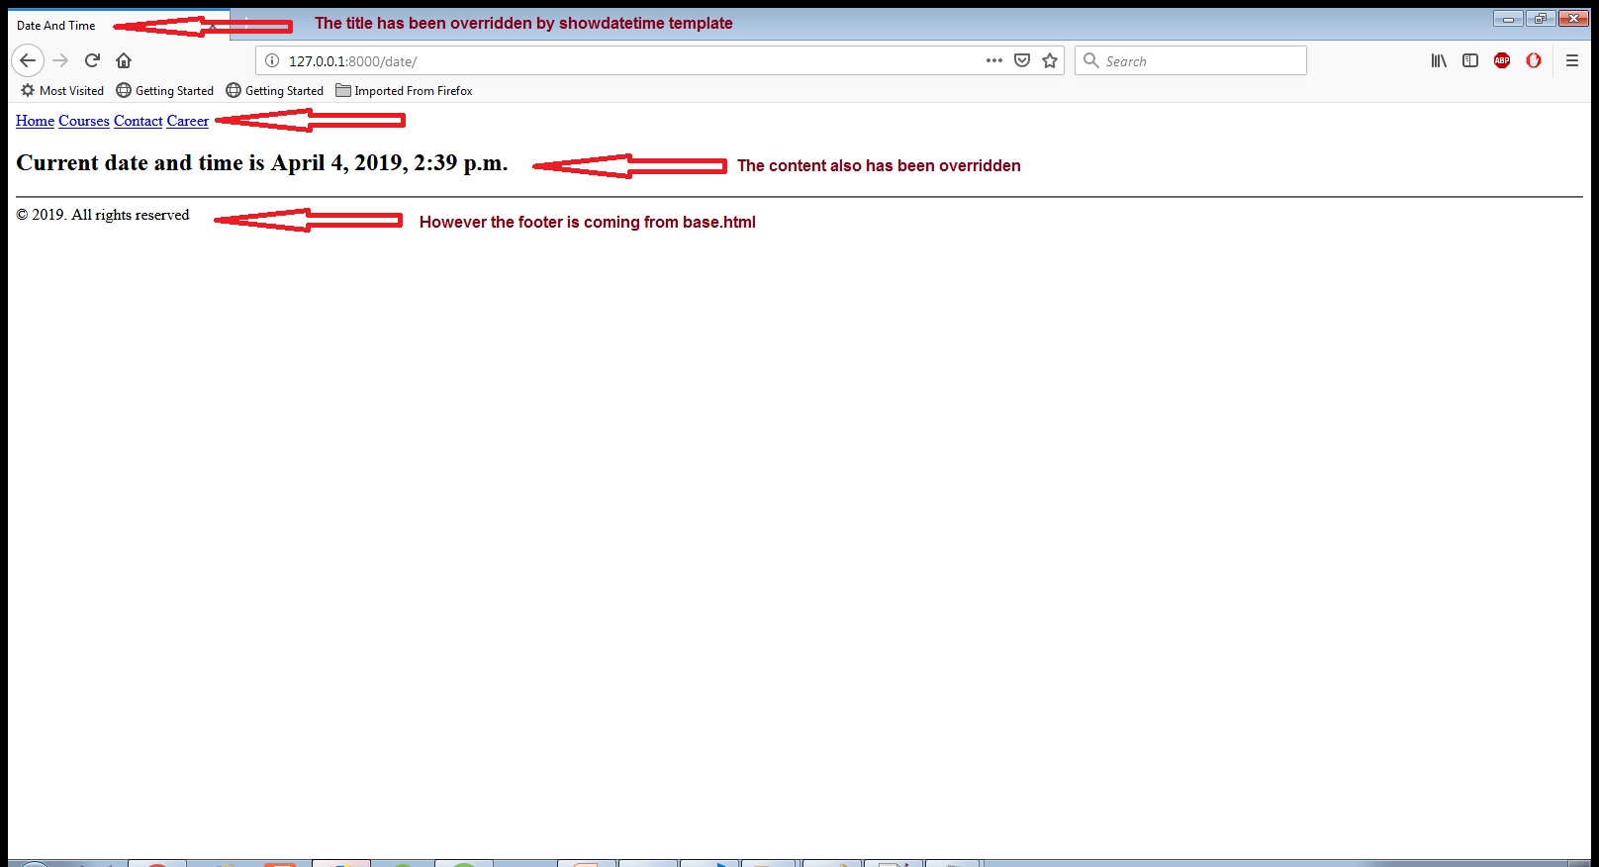
Output

Slide 26
Your Task
Now redesign the home.html and contact.html templates by inheriting the base.html template and overriding the necessary blocks.

Slide 27
The home.html Template
{% extends "templateapp5/base.html" %}
{% block content %}
<h3>Sharma Computer Academy</h3>
<p>
We at SCA are a group of highly skilled and qualified software professionals,<br>
who are working towards to attain mutual goal,<br>
the goal of "Moulding The Talented into Most Demanded".<br>
SCA is a premier organization founded in 1998,<br>
growing as an IT Training/service providers<br>
and determined to set high standards in IT industry.
</p>
<p>
We are offering courses in latest technologies of IT<br>
like Python, Django, JSE, JEE,C#(sharp), Asp.Net,PHP, Android,Networking and IPv6 Area (CCNA, CNE6 – Level 1 (Silver) and CNE6 – Level 2 (Gold)).<br>
SCA PIP (“Project Implementation Program”) will help students<br>
acquire specialized skills for project development.
</p>
{% endblock %}
</body>
</html>

Slide 28
The contact.html Template
{% extends "templateapp5/base.html" %}
{% block title %}
Contact
{% endblock %}
{% block content %}
<h3>How To Reach Us?</h3>
<p>
In case of any queries , feel free to fill the form<br>
given below and our <b></b>Customer Support Team</b> will
contact you within 24 hours.
</p>
<p>
<form>
Name: <input type="text" name="name" required> <br>
Email: <input type="email" name="email" required> <br>
Query: <textarea required></textarea> <br>
<input type="submit" name="submit" value="Send">
</form>
</p>
{% endblock %}
</body>
</html>

Slide 29
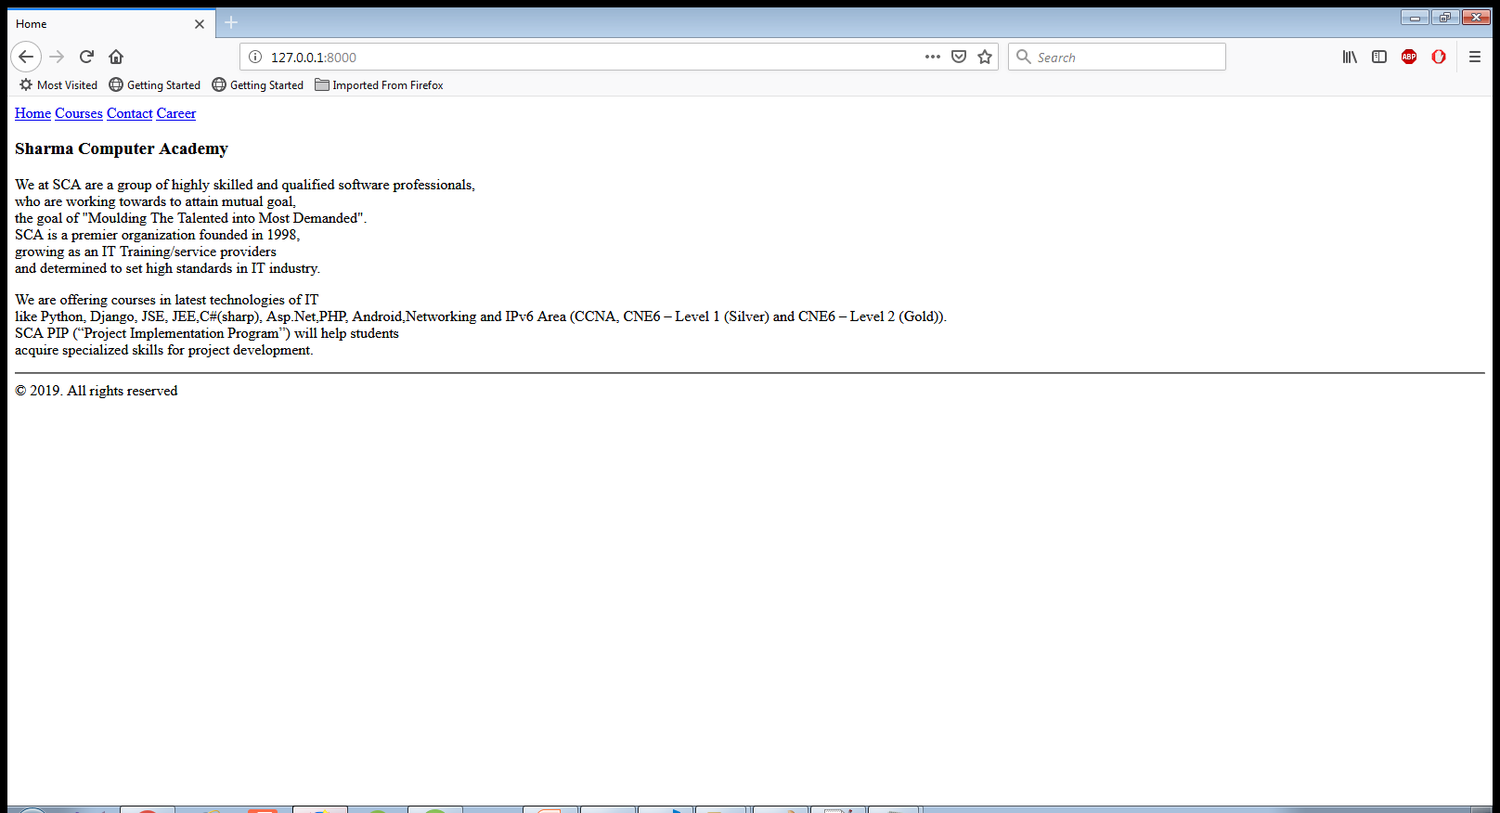
Output

Slide 30
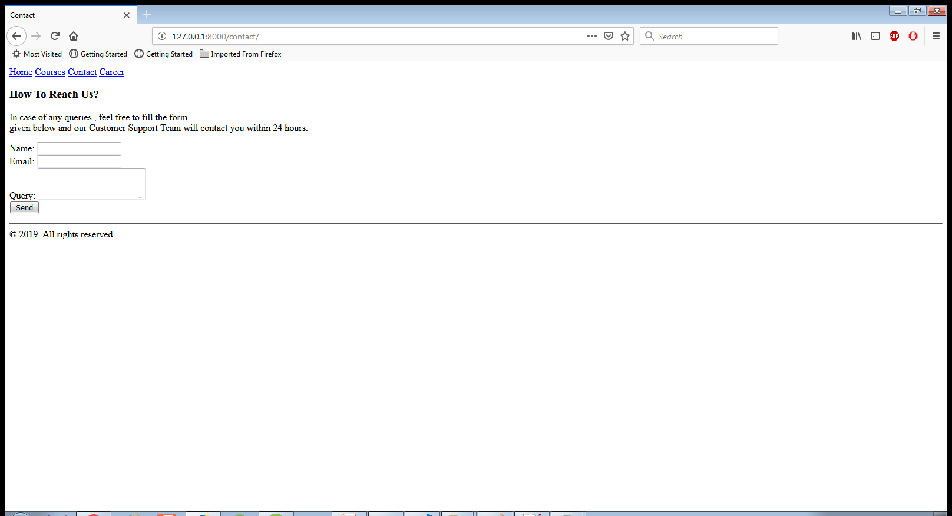
Output

